Slide 1
Final Team Project Milestone 2
Group 1:
Team Members:
Chaithanya Reddy Bogadi - 013803998
Naga Sindhu Korlapati - 012467832
Nandini Puppala - 013752713
Prathusha Koouri - 013710658
Sindhu Ravichandran - 013769821
Venkata Anil Kumar Thota - 012525734
CMPE257-Spring 2019

Slide 2
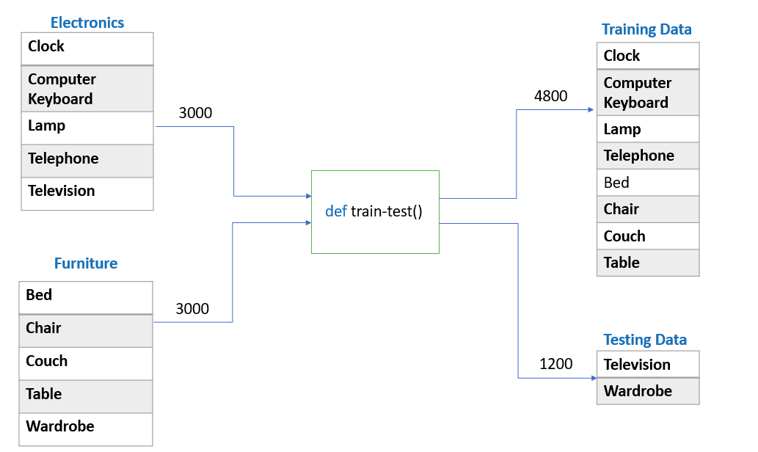
Data Preparation

Slide 3
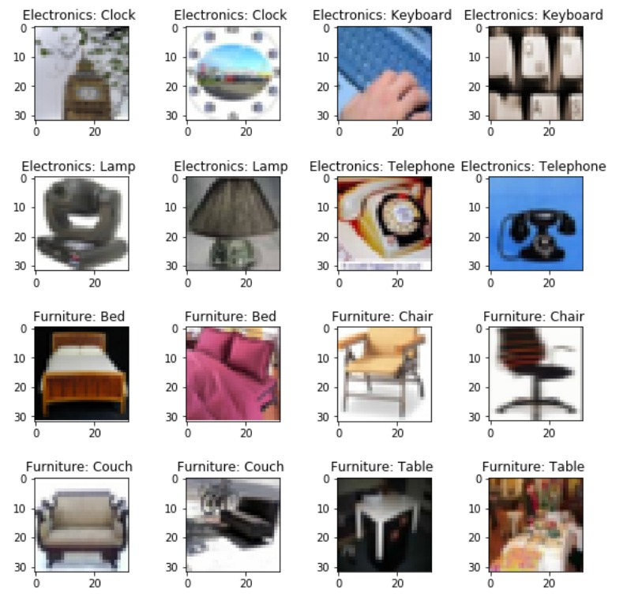
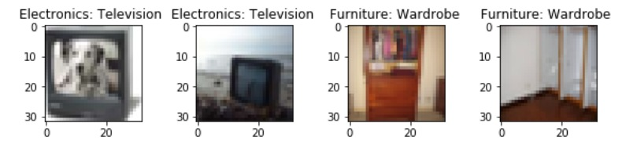
Validation Images
Train Data Test Data

Slide 4
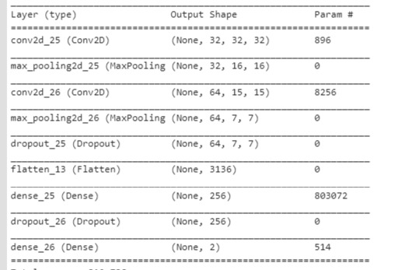
Best Model - CNN
Accuracy – 83.92% Labels = [clock, bed]

Slide 5
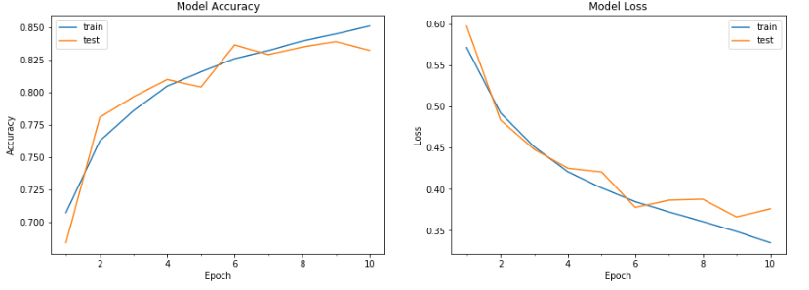
Best Model – CNN
Accuracy – 83.92% Labels = [clock, bed]

Slide 6
Confusion matrix
We have Considered:
Negative Class – Household Electronics
Positive Class – Household Furniture
True Negatives – 532
True Positives – 475
False Negatives – 125
False Positives – 68

Slide 7
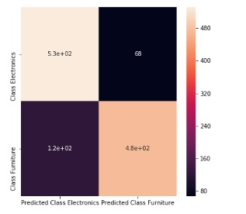
Confusion matrix using HeatMap

Slide 8
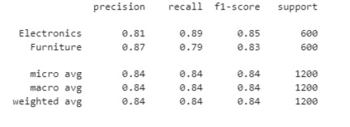
Classification Report

Slide 9
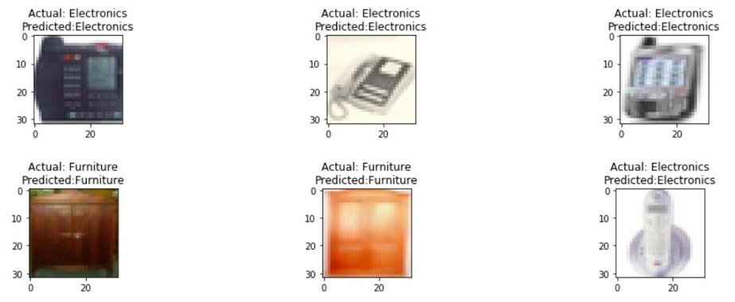
Predicted Images

Slide 10
Algorithm | Model Performance | Accuracy(%)
CNN | Best | 85.33
 | Average | 69.01
 | Median | 69.83
 | Least | 56.75
Logistic Regression | Best | 64.25
 | Average | 58.58
 | Median | 60.16
 | Least | 50
Random Forest | Best | 70.83
 | Average | 63.3
 | Median | 65.41
 | Least | 51.24
Gradient Boosting | Best | 71.33
 | Average | 63.5
 | Median | 64.66
 | Least | 55
SVM | Best | 71.92
 | Average | 64.2
 | Median | 66
 | Least | 51.08
XGBoost | Best | 70.25
 | Average | 63.05
 | Median | 64.67
 | Least | 53.42
KNN | Best | 65.91
 | Average | 56.96
 | Median | 57.91
 | Least | 41.41

Slide 11
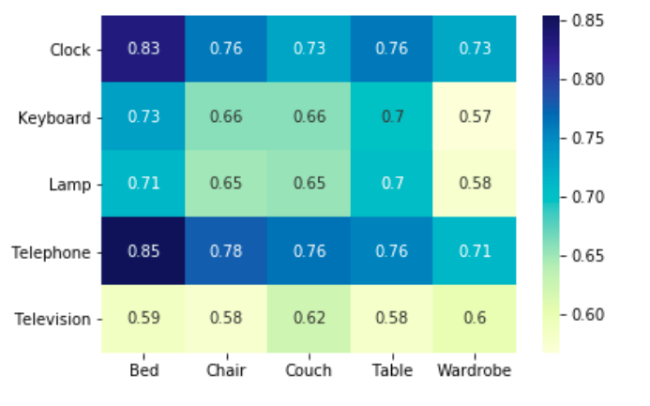
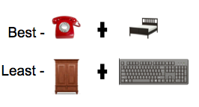
Heat Map of CNN model

Slide 12
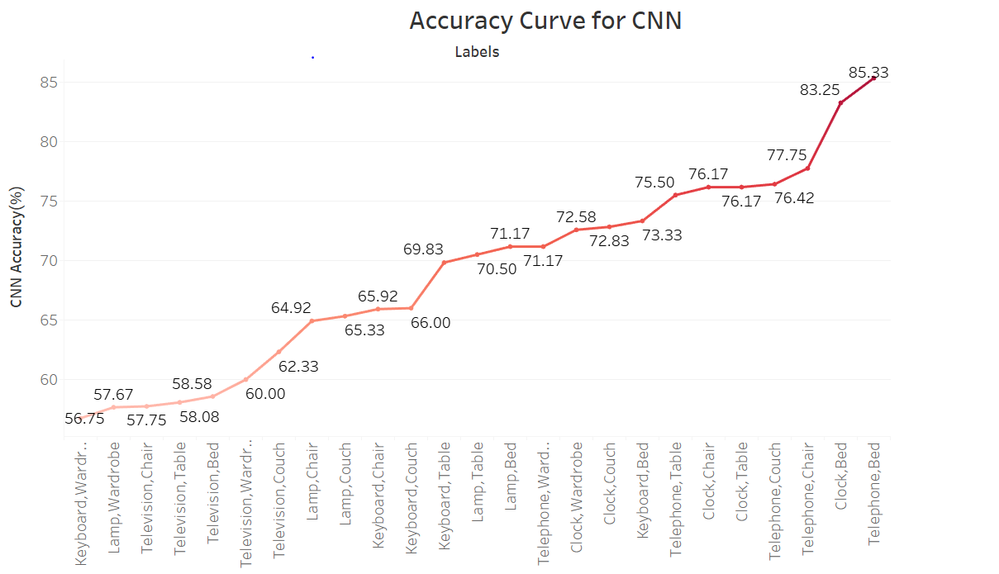

Slide 13
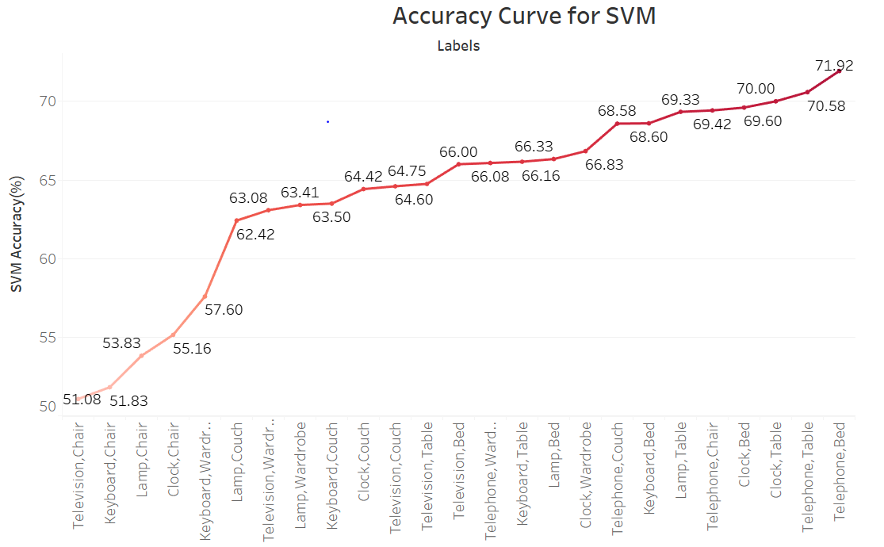

Slide 14
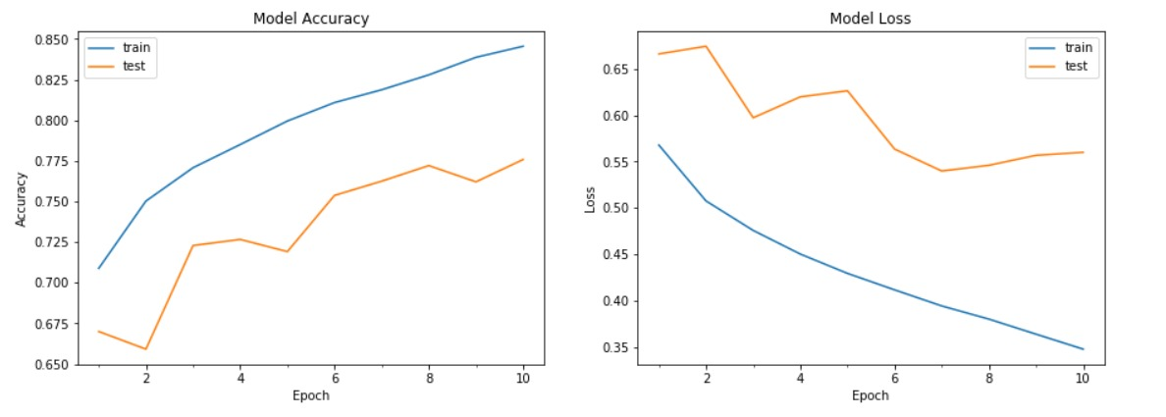
Accuracy with 4 Subclasses in Test Data
Accuracy – 77.50% Labels = [clock, telephone]
Labels = [bed,chair]

Slide 15

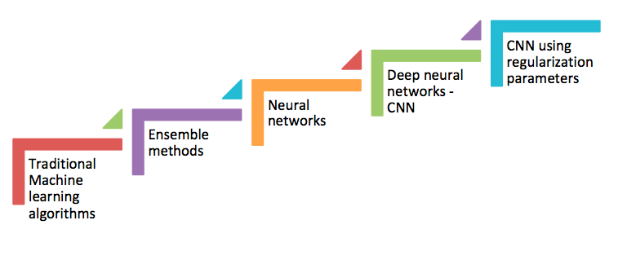
Achieved the results
CNN is the best model -

Slide 16
Lessons Learnt
Kernel, bias initialization
Batch normalization
Model checkpoint and save
Using GPU

Slide 17
THANK YOU

